Slide 1
You can find a video of this presentation here.
Notes:
https://channel9.msdn.com/Events/Connect/2017/G100

Slide 2
Application Modernization on Azure
Corey Sanders
Head of Product, Azure Compute
@CoreySandersWA

Slide 3
Value to Optimize and Modernize
Agility
Time to market
Total cost of ownership
IT simplification
Continuous delivery
Containers
Scalability and HA
Insights and Analytics
Infrastructure Cost
Ongoing Maintenance
Standardization
Simplification
Notes:
S

Slide 4




I don’t have the luxury of creating a new app from scratch. What can I do?
Do I really need to learn new languages and new tooling to use the cloud?
Can I reuse my existing codebase? I would love to build from there.

Slide 5
Cloud Maturity Model
Existing apps
on-prem
Lift and Shift
Cloud optimized
App modernized
Lift & Shift
Minimal code-changes
Architected for the cloud
modernized/refactor/rewrite
Notes:
Using an existing .NET application

Slide 6
Cloud Maturity Model
Existing apps
on-prem
Lift and Shift
Lift & Shift
Minimal code-changes

Slide 7
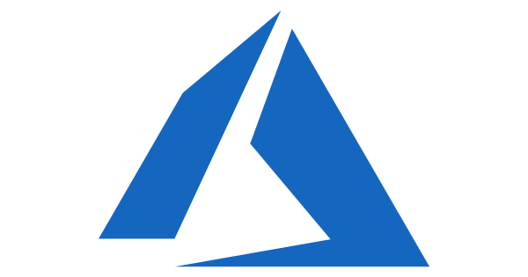


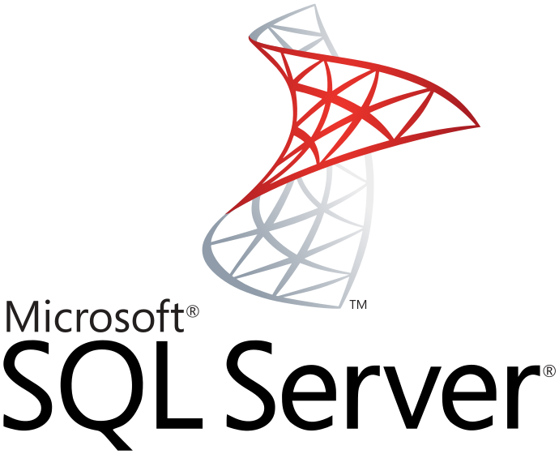

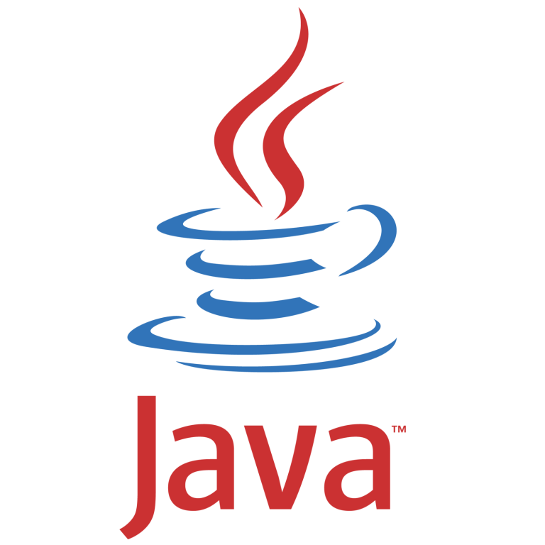
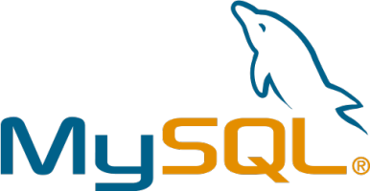

Lift and Shift Migrate your on-premise application to IaaS on Azure
Pros
Existing Apps
Web apps (on-prem.)
Lift & Shift
Web apps (Cloud)
No re-architect or new code
Least effort for quick migration
Supported on the least common denominator
On-Premises
IaaS Cloud (VMs)
Cons
Smaller cloud value
Manual patching, upgrades
No automated app scaling and high availability
Monolithic architecture
Monolithic architecture

Slide 8
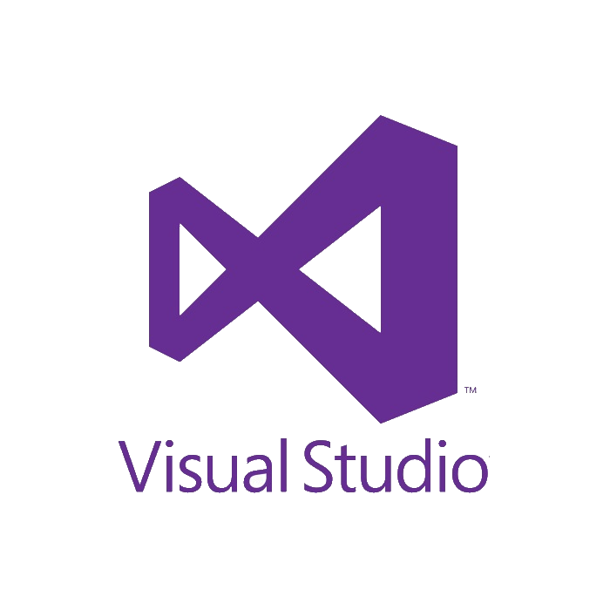

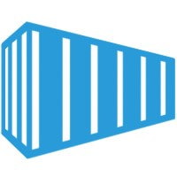
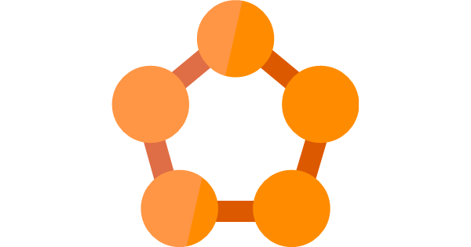
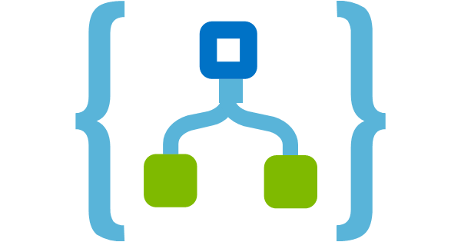
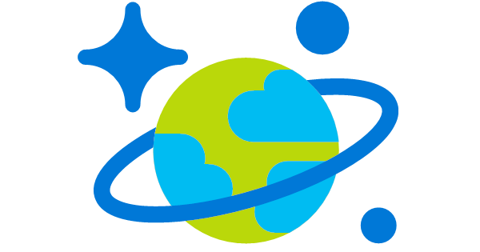
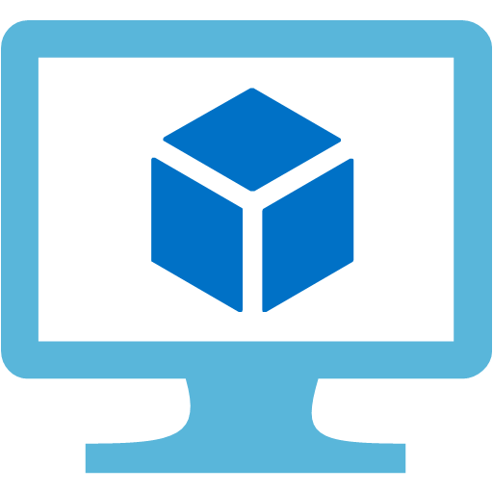



Twitter
Web front-end
(Web Forms)
Tweets DB
(Cosmos DB)
Twitter to Cosmos
(LogicApps)
Demo
Service tier
(WCF)
Listener (Stateless service)
Sentiment Analysis
Lift and Shift
Cloud Optimized
App Modernized
Data tier
(SQL VM)
Database
(SQL DB)
Database
(SQL Azure)
Database
(SQL Azure)

Slide 9
Cloud Maturity Model
Existing apps
on-prem
Lift and Shift
Cloud optimized
App modernized
Lift & Shift
Minimal code-changes
Architected for the cloud
modernized/refactor/rewrite

Slide 10
Cloud Maturity Model
Existing apps
on-prem
Lift and Shift
Cloud optimized
Lift & Shift
Minimal code-changes

Slide 11

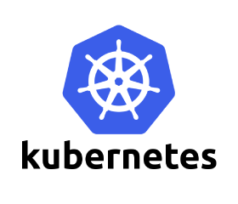
Cloud Optimized Get more Cloud benefit by Containerizing your app
Lift & Shift
Web apps (Cloud)
Pros
Existing apps
Web apps (on-prem.)
Orchestration and Managed Services
No re-architect or new code
Increased density & lower deployment cost
Improved productivity and DevOps agility
Portability of apps and dependencies
High availability with Orchestrators
On-Premises
Cons
Containerization is an additional step
Monolithic architecture

Slide 12
Virtual Machines
Docker Containers
App 1
App 2
App 3
Network isolation at container level
Resources constraints at container level
Bins/Libs
Bins/Libs
Bins/Libs
Guest OS
Guest OS
Guest OS
App 1
App 2
App 3
Bins/Libs
Bins/Libs
Bins/Libs
Hypervisor
Container engine
Host OS
Host OS
Infrastructure
Infrastructure

Slide 13

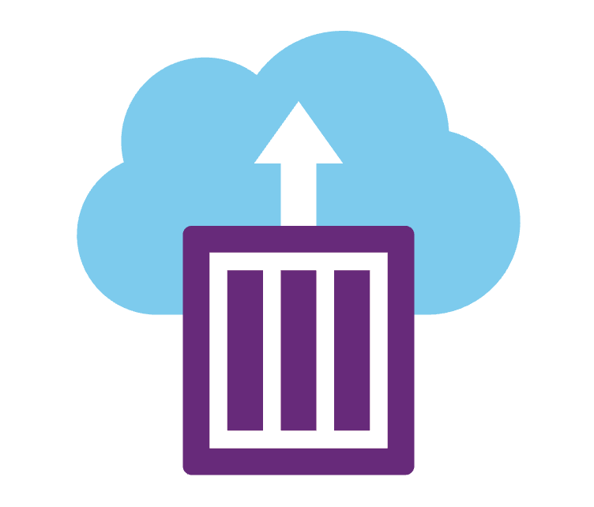
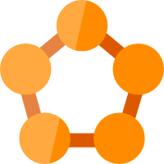

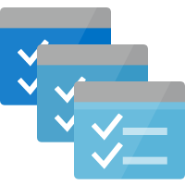
Deploy containers everywhere in Azure
ACI
AKS
Service Fabric
Web Apps
Batch

Slide 14
Azure Container Instances
Deploy containers with a single command
Launch container instances in seconds
Cost effective per second billing
ACI Bridge for Kubernetes

Slide 15
No infrastructure to manage
Fast start and stop
Fast scale without VM start-up

Slide 16
Controlled placement and HA
Effective resource utilization
Application co-location
Cloud VM
Cloud VM
Cloud VM

Slide 17
Service Fabric
Windows and Linux Containers
Stateless and stateful microservices
Deploy on Azure, Azure Stack and on-premises

Slide 18
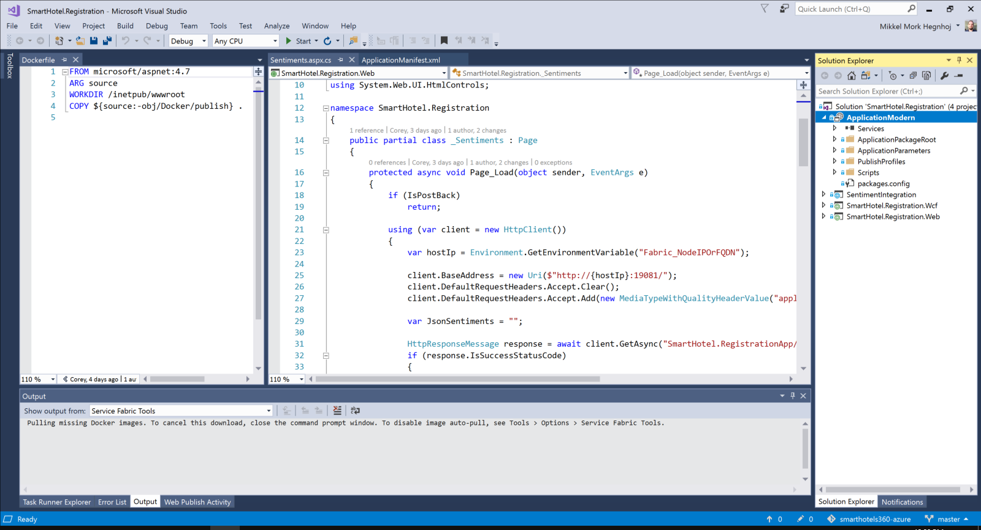
Visual Studio 2017 + Containers
Integrated Docker tooling
Develop, debug, test, deploy
End-to-end DevOps support

Slide 19
Twitter
Web front-end
(Web Forms)
Tweets DB
(Cosmos DB)
Twitter to Cosmos
(LogicApps)
Demo
Service tier
(WCF)
Listener (Stateless service)
Sentiment Analysis
Lift and Shift
Cloud Optimized
App Modernized
Data tier
(SQL VM)
Database
(SQL DB)
Database
(SQL Azure)
Database
(SQL Azure)

Slide 20

Great Partner Solutions
DC/OS
Pivotal
OpenShift
Docker Enterprise

Slide 21


.NET Foundation welcomes Steeltoe
+

Slide 22
Cloud Maturity Model
Existing apps
on-prem
Lift and Shift
Cloud optimized
App modernized
Lift & Shift
Minimal code-changes
Architected for the cloud
modernized/refactor/rewrite
Notes:
Using an existing .Net application

Slide 23
Cloud Maturity Model
Existing apps
on-prem
Lift and Shift
Cloud optimized
App modernized
Architected for the cloud
modernized/refactor/rewrite
Notes:
Using an existing .Net application

Slide 24


App Modernized Extend your apps with new cloud native services including serverless, microservices and PaaS.
Cloud-optimized full PaaS
Pros
Existing apps
Web apps (on-prem.)
Optimized for long term agility
Optimized for scale and high availability
Modern Architecture with Microservices
On-Premises
Cons
Requires significant code refactoring or rewriting
Monolithic architecture
Microservice architecture

Slide 25








Microsoft Azure Serverless Platform
Events
Blob Storage
Serverless Code
Resource Groups
Event Grid
Functions
Serverless Workflow and Integration
Azure Subscriptions
Logic Apps
Event Hubs
Other services and applications
Custom Events (anything)
Azure Automation
WebHooks (anything)

Slide 26
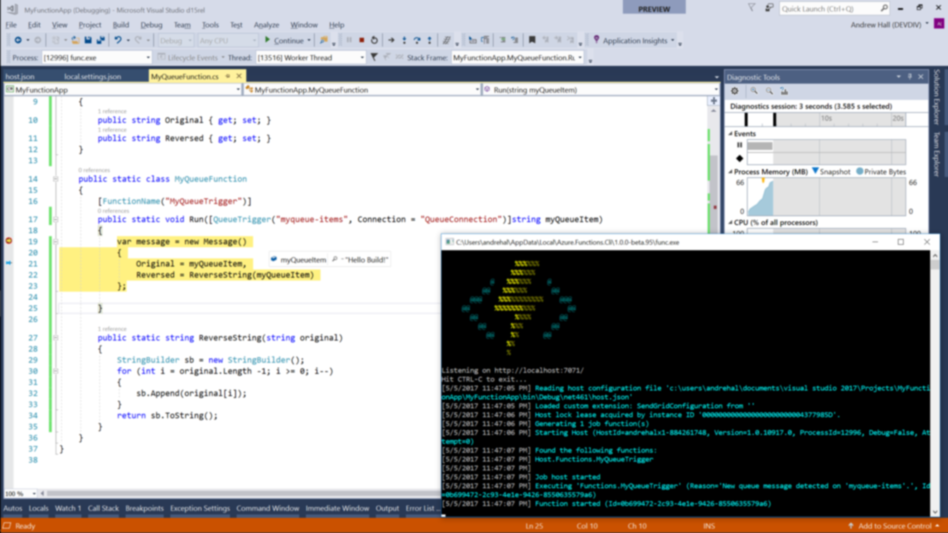
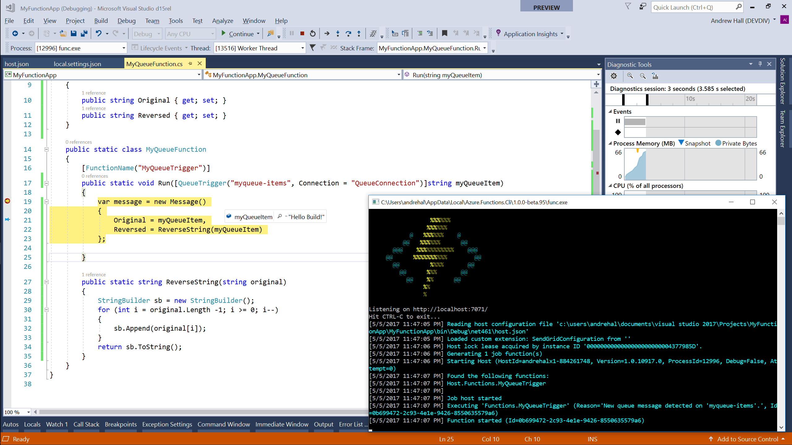

Azure Functions
On-demand serverless code
Develop, debug, deploy in Visual Studio & Visual Studio for Mac
CI/CD support in Visual Studio Team Services and Github
Notes:
Give Visual Studio for Mac [preview] a callout.

Slide 27
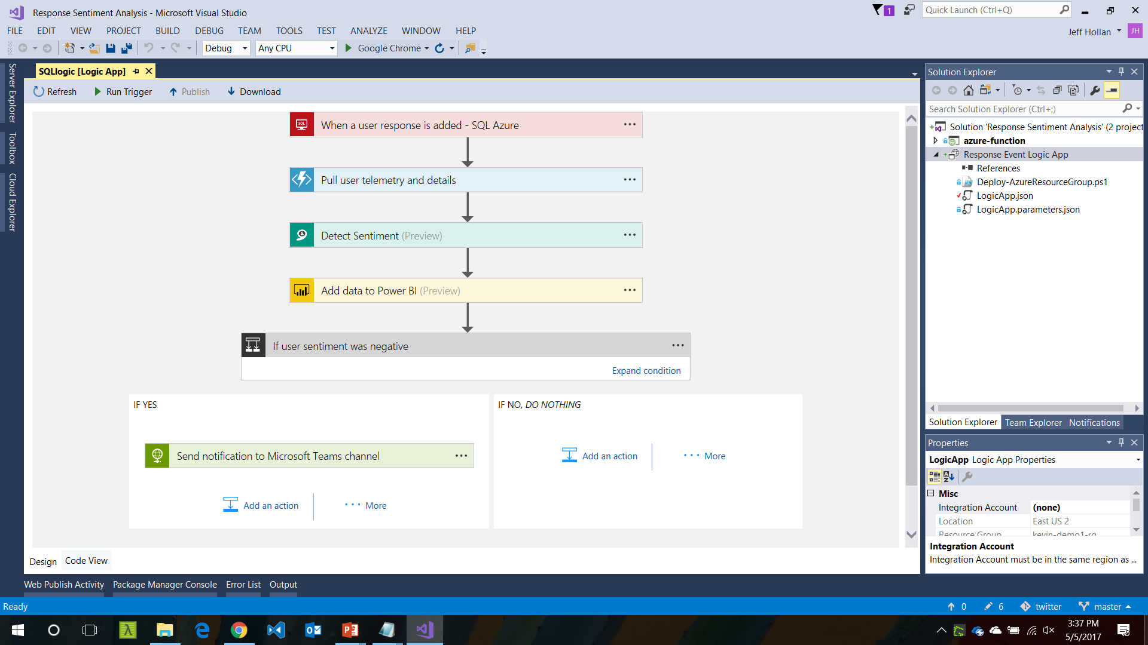


Azure Logic Apps
On-demand serverless workflows
100+ data and app connectors built-in
Integrated Visual Studio tooling

Slide 28

Language
Speech
Vision
Search
Knowledge
Azure Cognitive Services
Add the power of machine learning to any app
Process images, video, speech, language and more
Simple REST APIs

Slide 29
Twitter
Web front-end
(Web Forms)
Tweets DB
(Cosmos DB)
Twitter to Cosmos
(LogicApps)
Demo
Service tier
(WCF)
Listener (Stateless service)
Sentiment Analysis
Lift and Shift
Cloud Optimized
App Modernized
Data tier
(SQL VM)
Database
(SQL DB)
Database
(SQL Azure)
Database
(SQL Azure)

Slide 30
Cloud Maturity Model
Cloud Journey
Existing apps
on-prem
Lift and Shift
Cloud optimized
App modernized
Lift & Shift
Minimal code-changes
Architected for the cloud
modernized/refactor/rewrite

Slide 31
Now what?
Get started with Azure: aka.ms/azuregetstarted
Migrate to Azure: aka.ms/migratetothecloud
Source code available: aka.ms/smarthotels360azure

Slide 32
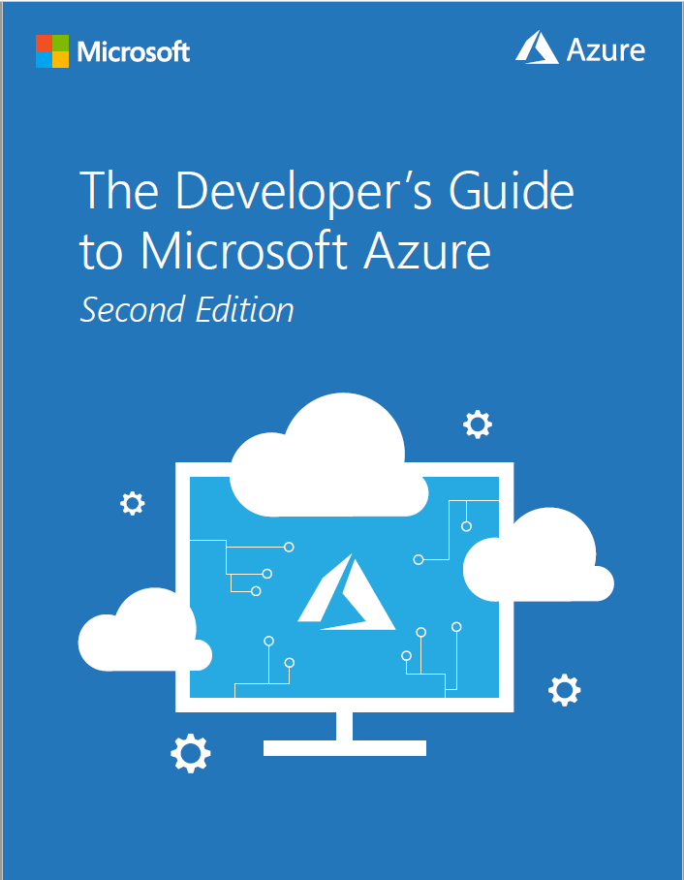
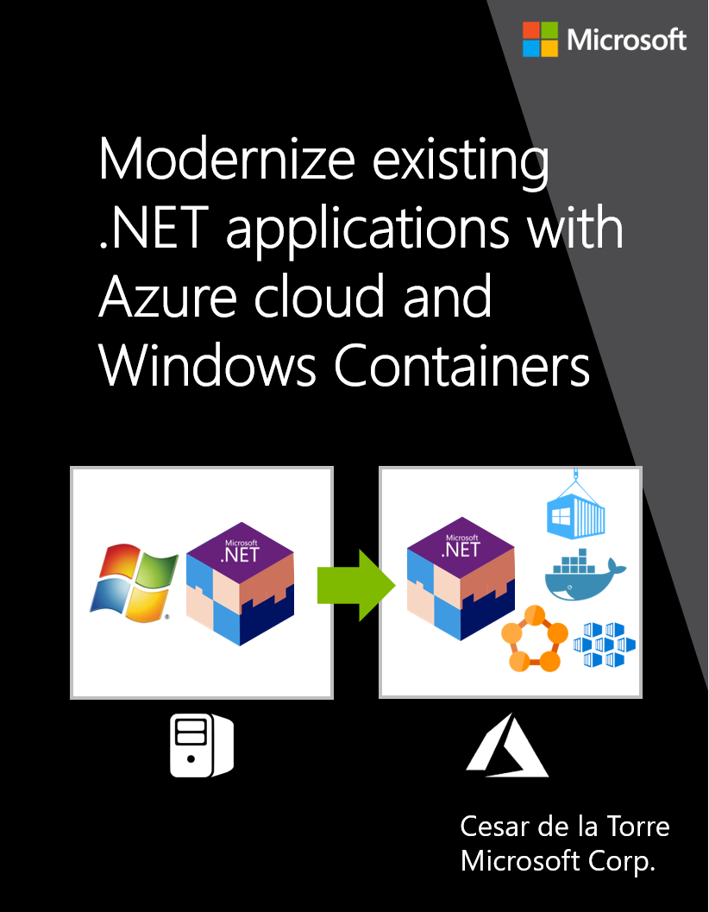
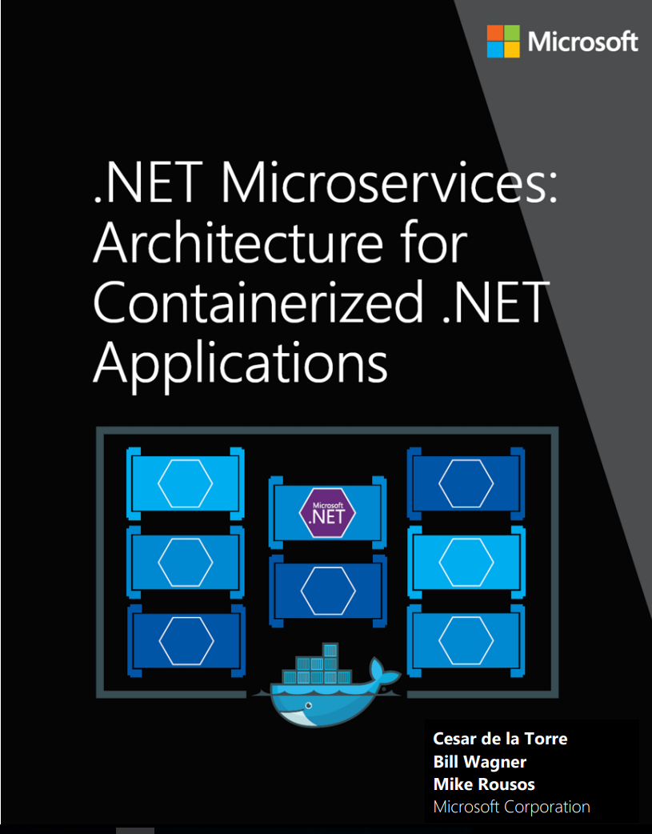
Free eBooks
Michael Crump
Barry Luijbregts
https://aka.ms/azuredevebook
https://aka.ms/modernizeappebook
https://aka.ms/microservicesebook

Slide 34
Twitter
Web front-end
(Web Forms)
Tweets DB
(Cosmos DB)
Twitter to Cosmos
(LogicApps)
Service tier
(WCF)
Listener (Stateless service)
Sentiment Analysis
Lift and Shift
Cloud Optimized
App Modernized
Data tier
(SQL VM)
Database
(SQL DB)
Database
(SQL Azure)
Database
(SQL Azure)

Slide 35
Cloud Maturity Model Application Modernization approaches
Currently working on this one should be finished 11/10 EOD
Lift and Shift
Existing apps & services
on-prem
App Modernized
Cloud Optimized
Lift & shift approaches
No code-changes
Architected for the cloud
modernized/refactor/rewrite

Slide 36
Twitter
Twitter to Cosmos
(LogicApps)
Web front-end
(Web Forms)
Listener (Stateless service)
Tweets DB
(Cosmos DB)
Demo
Service tier
(WCF)
Sentiment Analysis
Lift and Shift
Cloud Optimized
App Modernized
Data tier
(SQL VM)
Database
(SQL DB)
Database
(SQL Azure)
Database
(SQL Azure)

Slide 37


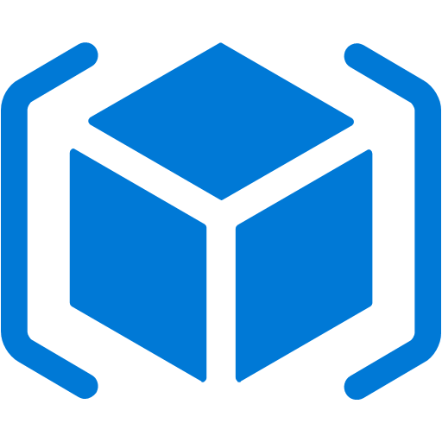




Microsoft Azure Serverless Platform
Events
Serverless Code
Blob Storage
Event Grid
Functions
Resource Groups
Azure Subscriptions
Serverless
Workflow & Integration
Logic Apps
Event Hubs
Custom Events (anything)
Other services and applications
Azure Automation
WebHooks (anything)

